Slide 1
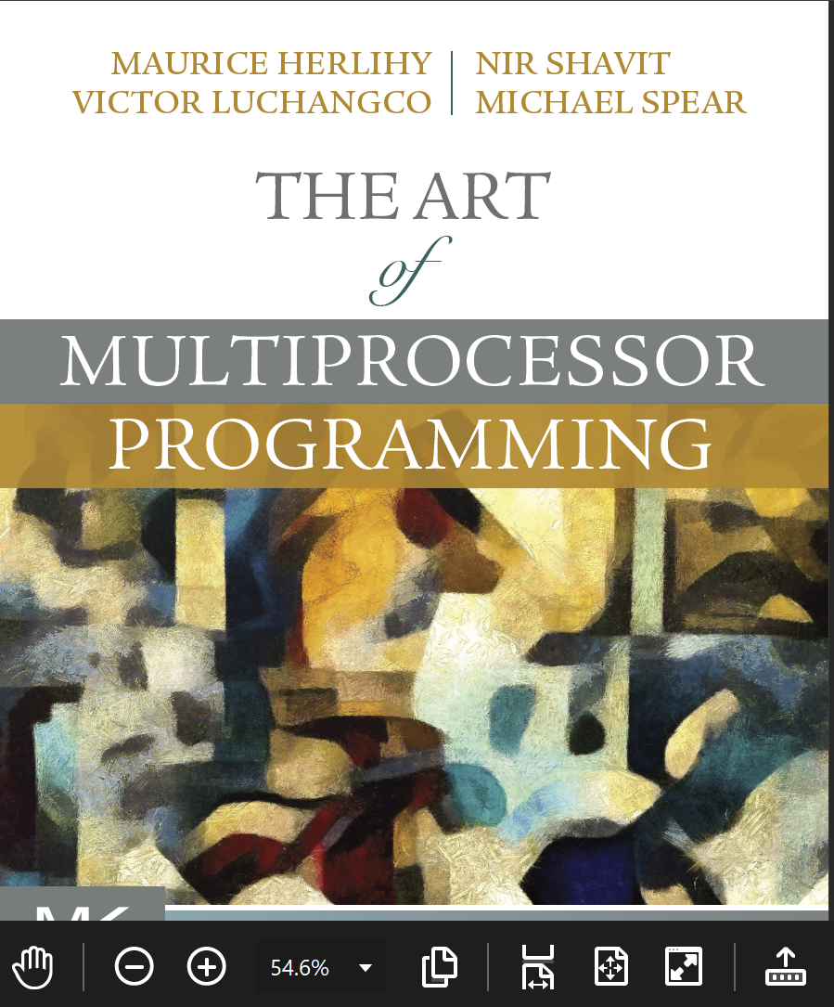
Transactional Memory
Companion slides for
The Art of Multiprocessor Programming
by Maurice Herlihy, Nir Shavit, Victor Luchangco, and Michael Spear
TexPoint fonts used in EMF.
Read the TexPoint manual before you delete this box.: AAAA
Notes:
1

Slide 2
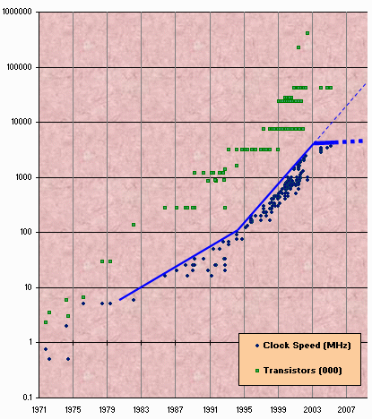
Moore’s Law
Transistor count still rising
Clock speed flattening sharply
Notes:
2
Most of you have probably heard of Moore’s law, which states that the number of transistors on a chip tends to double about every two years. Moore’s law has been the engine of growth for our field, and the reason you can buy a laptop for a few thousand dollars that would have cost millions a decade earlier. The green dots on this graph show

Slide 3
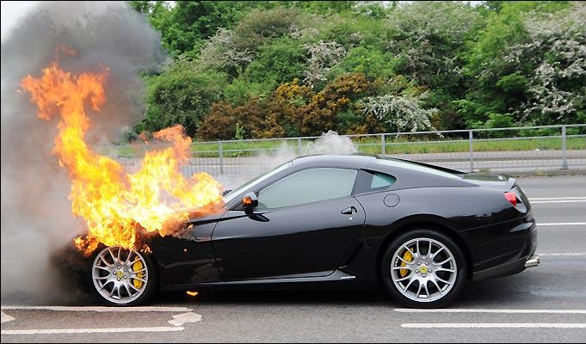
Moore’s Law (in practice)

Slide 4
The Uniprocessor (nearly extinct)
cpu
memory
Notes:
4
Traditionally, we have had inexpensive single processor with an associated memory on a chip, which we call a uniprocessor.

Slide 5
The Shared-Memory Multiprocessor (endangered)
cache
cache
cache
Bus
Bus
shared memory
Notes:
5
And we had expensive multiprocessor chips in the enterprise, that is, in server farms, high performance computing centers and so on. The
Shared memory multiprocessor (SMP) consists of multiple CPUs connected by a bus or interconnect network to a shared memory.

Slide 6
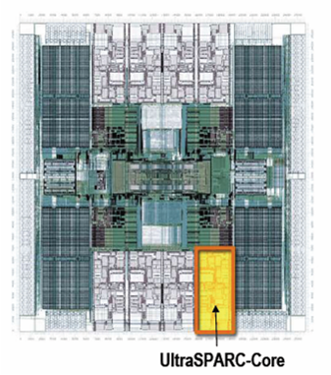
Multicore Processor (CMP): the New Boss
Processors, memory all on same chip
cache
cache
cache
Bus
Bus
shared memory
Notes:
6
The revolution we are going through is that the desktop is now becoming a multiprocessor also. We call this type of processor a system-on-a-chip or a multicore machine or a chip multiprocessor (CMP). The chip you see here is the Sun T2000 Niagara CMP that has 8 cores and shared cache and memory. We will learn about the Niagara in more detail later. It is the machine you will be using for your homework assignments.

Slide 7
Scaling before multicore
7x
3.6x
Speedup
1.8x
Code
Uniprocessor
Time: Moore’s law
Notes:
7
Recall the traditional scaling process for software: write it once, trust Intel to make the CPU faster to improve performance.

Slide 8
Ideal Multicore Scaling
7x
3.6x
Speedup
1.8x
Code
Unfortunately, not so easy …
Multicore
Notes:
8
With multicores, we will have to parallelize the code to make software faster, and we cannot do this automatically (except in a limited way on the level of individual instructions).

Slide 9
Actual Multicore Scaling
2x
2.9x
1.8x
Speedup
Exploiting parallelism
requires expertise!
Code
Multicore
Notes:
9
This is because splitting the application up to utilize the cores is not simple, and coordination among the various code parts requires care.

Slide 10
Amdahl’s Law
1-thread execution time
Speedup =
n-thread execution time
Notes:
10
This kind of analysis is very important for concurrent computation.
The formula we need is called \emph{Amdahl's Law}.
It captures the notion that the extent to
which we can speed up any complex job (not just painting)
is limited by how much of the job must be executed sequentially.
Define the \emph{speedup} $S$ of a job to be the ratio between the
time it takes one processor to complete the job (as measured by a wall clock)
versus the time it takes $n$ concurrent processors to complete the same job.
\emph{Amdahl's Law} characterizes the maximum speedup $S$ that can be achieved by $n$
processors collaborating on an application where $p$ is the fraction of
the job that can be executed in parallel.
Assume, for simplicity,
that it takes (normalized) time 1 for a single processor to complete the job.
With $n$ concurrent processors, the parallel part takes time $p/n$ and the sequential part takes time $1-p$.
Overall, the parallelized computation takes time:
$$
1 - p + \frac{p}{n}
$$
Amdahl's Law says that the speedup, that is,
the ratio between the sequential (single-processor) time and the parallel time,
is:
$$
S = \frac{1}{1 - p + \frac{p}{n}}
$$
We show this in the next set of slides

Slide 11

Amdahl’s Law
$$\frac{1}{1+p+\frac{p}{n}}$$
Speedup=
Notes:
11
AVOID USING THE WORD “CODE”, P is not a fraction of the code but if the execution time of the solution algorithm. It could be that 5% of the code are executed in a loop and account for 90% of the execution time.

Slide 12
Amdahl’s Law
parallel fraction
$$\frac{1}{1+p+\frac{p}{n}}$$
Speedup=
Notes:
12
AVOID USING THE WORD “CODE”, P is not a fraction of the code but if the execution time of the solution algorithm. It could be that 5% of the code are executed in a loop and account for 90% of the execution time.

Slide 13
Amdahl’s Law
parallel fraction
$$\frac{1}{1+p+\frac{p}{n}}$$
Speedup=
Number of threads
Notes:
13
AVOID USING THE WORD “CODE”, P is not a fraction of the code but if the execution time of the solution algorithm. It could be that 5% of the code are executed in a loop and account for 90% of the execution time.

Slide 14
Amdahl’s Law
parallel fraction
$$\frac{1}{1+p+\frac{p}{n}}$$
Speedup=
Number of threads
Notes:
14
AVOID USING THE WORD “CODE”, P is not a fraction of the code but if the execution time of the solution algorithm. It could be that 5% of the code are executed in a loop and account for 90% of the execution time.

Slide 15
Amdahl’s Law
sequential fraction
parallel fraction
$$\frac{1}{1+p+\frac{p}{n}}$$
Speedup=
Number of threads
Notes:
15
AVOID USING THE WORD “CODE”, P is not a fraction of the code but if the execution time of the solution algorithm. It could be that 5% of the code are executed in a loop and account for 90% of the execution time.

Slide 16

Amdahl’s Law in Practice
Bad synchronization ruins everything

Slide 17
Example
You buy a 10-core machine …
Your application is:
60% concurrent
40% sequential
How close to a 10-fold speedup?
17
Notes:
17

Slide 18
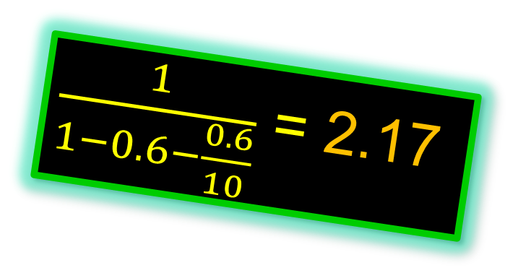
Example
You buy a 10-core machine …
Your application is:
60% concurrent
$\frac{1}{1−0.6−\frac{0.6}{10}}$ = 2.17
40% sequential
How close to a 10-fold speedup?
18
Notes:
18

Slide 19
Example
You buy a 10-core machine …
Your application is:
80% concurrent
20% sequential
How close to a 10-fold speedup?
19
Notes:
19

Slide 20
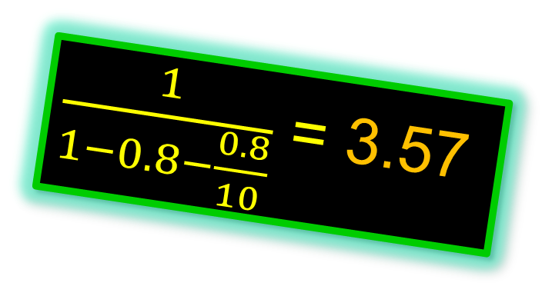
Example
You buy a 10-core machine …
Your application is:
80% concurrent
$\frac{1}{1−0.8−\frac{0.8}{10}}$ = 3.57
20% sequential
How close to a 10-fold speedup?
20
Notes:
20

Slide 21
Example
You buy a 10-core machine …
Your application is:
90% concurrent
10% sequential
How close to a 10-fold speedup?
21
Notes:
21

Slide 22
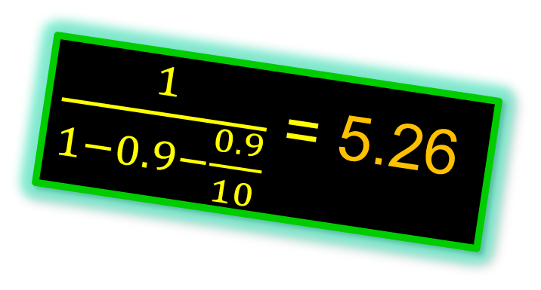
Example
You buy a 10-core machine …
Your application is:
90% concurrent
$\frac{1}{1−0.9−\frac{0.9}{10}}$ = 5.26
10% sequential
How close to a 10-fold speedup?
22
Notes:
22

Slide 23
Example
You buy a 10-core machine …
Your application is:
99% concurrent
01% sequential
How close to a 10-fold speedup?
23
Notes:
23

Slide 24
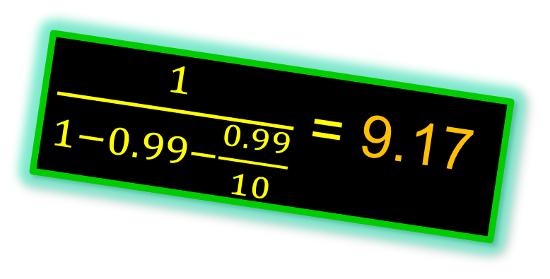
Example
You buy a 10-core machine …
Your application is:
99% concurrent
$\frac{1}{1−0.99−\frac{0.99}{10}}$ = 9.17
01% sequential
How close to a 10-fold speedup?
24
Notes:
24

Slide 25
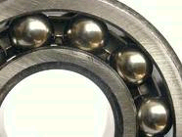
Diminishing Returns
This lecture is about the parts that
are hard to make concurrent …
but still have a big influence on speedup!
Notes:
With 25% sequential, cannot do more than

Slide 26
Locking
26
Notes:
26

Slide 27
Coarse-Grained Locking
Easily made correct …
But not scalable.
27
Notes:
27

Slide 28
Fine-Grained Locking
Can be very tricky …
28
Notes:
28

Slide 29
Locks do not tolerate faults
If a thread holding
a lock is delayed …
No one else can make progress
29
Notes:
29

Slide 30
Locking Relies on Conventions
Relation between …
Lock data and object data …
Exists only in programmer’s mind
/*
* When a locked buffer is visible to the I/O layer
* BH_Launder is set. This means before unlocking
* we must clear BH_Launder,mb() on alpha and then
* clear BH_Lock, so no reader can see BH_Launder set
* on an unlocked buffer and then risk to deadlock.
*/
Actual comment from Linux Kernel
(hat tip: Bradley Kuszmaul)

Slide 31
Simple Problems are hard
enq(x)
double-ended queue
enq(y)
No interference if ends “far apart”
Interference OK if queue is small
Clean solution is publishable result:
[Michael & Scott PODC 97]
31
Notes:
31

Slide 32
Locks do not compose
Transfer item from one queue to another
Must be atomic :
No duplicate or missing items
32
Notes:
32

Slide 33
Locks do not compose
Lock source
Unlock source & target
Lock target
33
Notes:
33

Slide 34
Locks do not compose
Lock source
Methods cannot provide internal synchronization
Unlock source & target
Objects must expose locking protocols to clients
Lock target
Clients must devise and follow protocols
Abstraction broken!
34
Notes:
34

Slide 35
Monitor Wait and Signal
Empty
zzz
buffer
Yes!
If buffer is empty,
wait for item to show up
35
Notes:
35

Slide 36
Monitor Wait and Signal Do Not Compose
empty
empty
zzz…
Wait for either?
36
Notes:
36

Slide 37

The Transactional Manifesto
Much modern programming practice inadequate for multicore world
Agenda
Replace locking with a transactional API
Design languages and libraries
Implement efficient run-times
37

Slide 38
Road Map
Transactions vs Locks
Hardware Transactional Memory
Using Transactional Memory
Transactions with Locks?
Research Questions

Slide 39
Road Map
Transactions vs Locks
Hardware Transactional Memory
Using Transactional Memory
Transactions with Locks?
Research Questions

Slide 40
Transactions
Block of code ….
Atomic: appears to happen instantaneously
Serializable: all appear to happen in one-at-a-time order
Commit: takes effect (atomically)
Abort: has no effect (typically restarted)
40

Slide 41

Atomic blocks
atomic { x.remove(3);
y.add(3); } atomic { y = null;
}
41

Slide 42
Atomic blocks
atomic { x.remove(3);
y.add(3); } atomic { y = null;
}
Safe
(no data race)
42

Slide 43
A Double-Ended Queue
public void LeftEnq(item x) {
Qnode q = new Qnode(x);
q.left = left;
left.right = q;
left = q;
}
Write sequential Code
43
Notes:
43

Slide 44
A Double-Ended Queue
public void LeftEnq(item x)
atomic {
Qnode q = new Qnode(x);
q.left = left;
left.right = q;
left = q;
}
}
Enclose in atomic block
44

Slide 45

Warning
Not always this simple!
Conditional waits?
False conflicts?
Resource limits?
Better problems to have …
45

Slide 46
Composition?
46
Notes:
46

Slide 47
Composition?
public void Transfer(Queue<T> q1, q2)
{
atomic {
T x = q1.deq();
q2.enq(x);
}
}
Trivial or what?
47
Notes:
47

Slide 48
Conditional Waiting
public T LeftDeq() {
atomic {
if (left == null)
retry;
…
}
}
Roll back transaction and restart when something changes
48

Slide 49
Composable Conditional Waiting
atomic {
x = q1.deq();
} orElse {
x = q2.deq();
}
Run 1st method. If it retries …
Run 2nd method. If it retries …
Entire statement retries
49

Slide 50
Road Map
Transactions vs Locks
Hardware Transactional Memory
Using Transactional Memory
Transactions with Locks?
Research Questions

Slide 51


Hardware Transactional Memory
Exploit standard cache coherence
Detect synchronization conflicts …
Invalidate cached copies of data.
51
51
Notes:
51
Original TM proposal by Herlihy and Moss 1993…

Slide 52
Standard Cache Coherence
cache
cache
cache
Bus
memory
Notes:
We are going to do yet another review of multiprocessor architecture.

Slide 53
Standard Cache Coherence
Random access memory (10s of cycles)
cache
cache
cache
Bus
memory
Notes:
We are going to do yet another review of multiprocessor architecture.

Slide 54
Standard Cache Coherence
Shared Bus
Broadcast medium
One broadcaster at a time
Processors and memory all “snoop”
cache
cache
cache
Bus
memory
Notes:
We are going to do yet another review of multiprocessor architecture.

Slide 55
Standard Cache Coherence
Per-Processor Caches
Small
Fast: 1 or 2 cycles
Address & state information
cache
cache
cache
Bus
memory
Notes:
We are going to do yet another review of multiprocessor architecture.

Slide 56
Processor issues load
load x
cache
cache
cache
Bus
Bus
memory
data
Notes:
We are going to do yet another review of multiprocessor architecture.

Slide 57
Processor issues load
load x
E
cache
cache
cache
Bus
Bus
memory
data
data
Notes:
We are going to do yet another review of multiprocessor architecture.

Slide 58
Another processor issues load
Load x
E
cache
data
cache
cache
Bus
Bus
memory
data
Notes:
We are going to do yet another review of multiprocessor architecture.

Slide 59
Another processor issues load
Load x
E
cache
data
cache
cache
Bus
Bus
memory
data
Notes:
We are going to do yet another review of multiprocessor architecture.

Slide 60
Other processor responds
Got it
S
S
E
data
data
cache
cache
Bus
Bus
memory
data
Notes:
When the second processor asks for x, the first one, who is snooping on the bus, responds with the data. (It can respond faster than the memory). Both processors mark that cache line as shared.

Slide 61
Modify Cached Data
S
S
data
data
data
cache
Bus
memory
data

Slide 62
Invalidate everyone else’s cached data
Invalidate x
S
S
M
I
data
data
cache
cache
Bus
Bus
memory
data

Slide 63
Invalidate everyone else’s cached data
cache
data
cache
Bus
This cache acquires write permission
memory
data
Notes:
From this point on, the red processor can update that data value without causing any bus traffic, because it knows that it has the only cached copy. This is much more efficient than a write-through cache because it produces much less bus traffic.

Slide 64
Invalidate everyone else’s cached data
Other caches lose read permission
cache
data
cache
Bus
This cache acquires write permission
memory
data
Notes:
From this point on, the red processor can update that data value without causing any bus traffic, because it knows that it has the only cached copy. This is much more efficient than a write-through cache because it produces much less bus traffic.

Slide 65
Invalidate everyone else’s cached data
Memory provides data only if not present in any cache, so no need to change it now (expensive)
cache
data
cache
Bus
memory
data
Notes:
Finally, there is no need to update memory until the processor wants to use that cache space for something else. Any other processor that asks for the data will get it from the red processor.

Slide 66
Hardware Transactional Memory
read
active
T
caches
Interconnect
memory
66
66
Notes:
66

Slide 67
Hardware Transactional Memory
read
active
active
T
T
caches
memory
67
67
Notes:
67

Slide 68
Hardware Transactional Memory
active
committed
active
T
T
caches
memory
68
68
Notes:
68

Slide 69
Hardware Transactional Memory
write
committed
active
T
D
caches
memory
69
69
Notes:
69

Slide 70
Rewind
write
aborted
active
active
T
D
T
caches
memory
70
70
Notes:
70

Slide 71
Rewind
At Commit point …
No cache conflicts? We win.
Mark transactional cache entries ….
Was: read-only, Now: valid
Was: modified, Now: dirty
(will be written back)
That’s (almost) everything!
71
71
Notes:
71

Slide 72
Road Map
Transactions vs Locks
Hardware Transactional Memory
Using Transactional Memory
Transactions with Locks?
Research Questions

Slide 73
Hardware Transactional Memory (HTM)
IBM’s Blue Gene/Q & System Z & Power8
Intel’s TSX extensions
73

Slide 74
Intel TSX
if (_xbegin() == _XBEGIN_STARTED) {
speculative code
_xend()
} else {
abort handler
}

Slide 75
Intel TSX
if (_xbegin() == _XBEGIN_STARTED) {
speculative code
_xend()
} else {
abort handler
}
start a speculative transaction

Slide 76
Intel TSX
if (_xbegin() == _XBEGIN_STARTED) {
speculative code
_xend()
} else {
abort handler
}
If you see this, you are inside a transaction

Slide 77
Intel TSX
if (_xbegin() == _XBEGIN_STARTED) {
speculative code
_xend()
} else {
abort handler
}
If you see anything else, your transaction aborted

Slide 78
Intel TSX
if (_xbegin() == _XBEGIN_STARTED) {
speculative code
_xend()
} else {
abort handler
}
you could retry the transaction, or take an alternative path

Slide 79
Abort Codes
if (_xbegin() == _XBEGIN_STARTED) {
speculative code
} else if (status & _XABORT_EXPLICIT) {
aborted by user code
} else if (status & _XABORT_CONFLICT) {
read-write conflict
} else if (status & _XABORT_CAPACITY) {
cache overflow
} else {
…
}

Slide 80
Abort Codes
if (_xbegin() == _XBEGIN_STARTED) {
speculative code
} else if (status & _XABORT_EXPLICIT) {
aborted by user code
} else if (status & _XABORT_CONFLICT) {
read-write conflict
} else if (status & _XABORT_CAPACITY) {
cache overflow
} else {
…
}
speculative code can call _xabort()

Slide 81
Abort Codes
if (_xbegin() == _XBEGIN_STARTED) {
speculative code
} else if (status & _XABORT_EXPLICIT) {
aborted by user code
} else if (status & _XABORT_CONFLICT) {
read-write conflict
} else if (status & _XABORT_CAPACITY) {
cache overflow
} else {
…
}
synchronization conflict occurred (maybe retry)

Slide 82
Abort Codes
if (_xbegin() == _XBEGIN_STARTED) {
speculative code
} else if (status & _XABORT_EXPLICIT) {
aborted by user code
} else if (status & _XABORT_CONFLICT) {
read-write conflict
} else if (status & _XABORT_CAPACITY) {
cache overflow
} else {
…
}
read/write set too big (maybe don’t retry)

Slide 83
Abort Codes
if (_xbegin() == _XBEGIN_STARTED) {
speculative code
} else if (status & _XABORT_EXPLICIT) {
aborted by user code
} else if (status & _XABORT_CONFLICT) {
read-write conflict
} else if (status & _XABORT_CAPACITY) {
cache overflow
} else {
…
}
other abort codes …

Slide 84
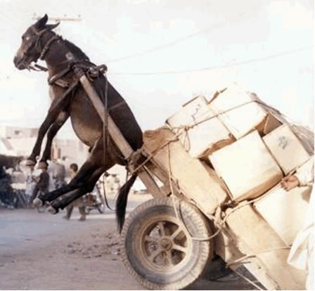
Transaction too big?
Transaction aborts if data set overflows caches, internal buffers

Slide 85
Transaction too slow?
Transaction aborts on timer interrupt

Slide 86

Transaction just not in the mood?
Many other reasons: TLB miss, illegal instruction, page fault …

Slide 87

Hybrid Transactional Memory

Slide 88
Hybrid Transactional Memory
if (_xbegin() == _XBEGIN_STARTED) {
read lock state
if (lock taken) _xabort();
work;
_xend()
} else {
lock->lock();
work;
lock->unlock();
}

Slide 89
Hybrid Transactional Memory
if (_xbegin() == _XBEGIN_STARTED) {
read lock state
if (lock taken) _xabort();
work;
_xend()
} else {
lock->lock();
work;
lock->unlock();
}
reading lock ensures that transaction will abort if another thread acquires lock

Slide 90
Hybrid Transactional Memory
if (_xbegin() == _XBEGIN_STARTED) {
read lock state
if (lock taken) _xabort();
work;
_xend()
} else {
lock->lock();
work;
lock->unlock();
}
abort if another thread has acquired lock

Slide 91
Hybrid Transactional Memory
on abort, acquire lock & do work
(aborts other speculative txns)
if (_xbegin() == _XBEGIN_STARTED) {
read lock state
if (lock taken) _xabort();
work;
_xend()
} else {
lock->lock();
work;
lock->unlock();
}

Slide 92
Lock Elision
<HLE acquire prefix> lock();
do work;
<HLE release prefix> unlock()
92

Slide 93
Lock Elision
<HLE acquire prefix> lock();
do work;
<HLE release prefix> unlock()
first time around,
read lock and
execute speculatively
93

Slide 94
Lock Elision
<HLE acquire prefix> lock();
do work;
<HLE release prefix> unlock()
if speculation fails,
acquire the lock
94

Slide 95
Lock Elision
<HLE acquire prefix> lock();
do work;
<HLE release prefix> unlock()
Supported by Intel TSX
Can speed up legacy code!
95

Slide 96

Lock Teleportation

Slide 97
Hand-over-hand Locking
a
b
c

Slide 98
Hand-over-hand Locking
a
b
c

Slide 99
Hand-over-hand Locking
a
b
c

Slide 100
Hand-over-hand Locking
a
b
c

Slide 101
Removing a Node
a
b
c
d
remove(b)
101
Notes:
101

Slide 102
Removing a Node
a
b
c
d
remove(b)
Notes:
Here is a naive approach to removing a node. Each thread locks the node being examined and its predecessor.

Slide 103
Removing a Node
a
b
c
d

Slide 104
Lock Teleportation
read transaction
a
b
c
d

Slide 105
Lock Teleportation
read transaction
a
b
c
d

Slide 106
Lock Teleportation
no locks acquired
a
b
c
d

Slide 107
How Far to Teleport?
Too short?
Missed opportunity
Too far?
Transaction aborts, work lost

Slide 108
Adaptive Teleportation
On Success:
limit = limit + 1
On Failure:
limit = limit / 2

Slide 109
Road Map
Transactions vs Locks
Hardware Transactional Memory
Using Transactional Memory
Transactions with Locks?
Research Questions

Slide 110
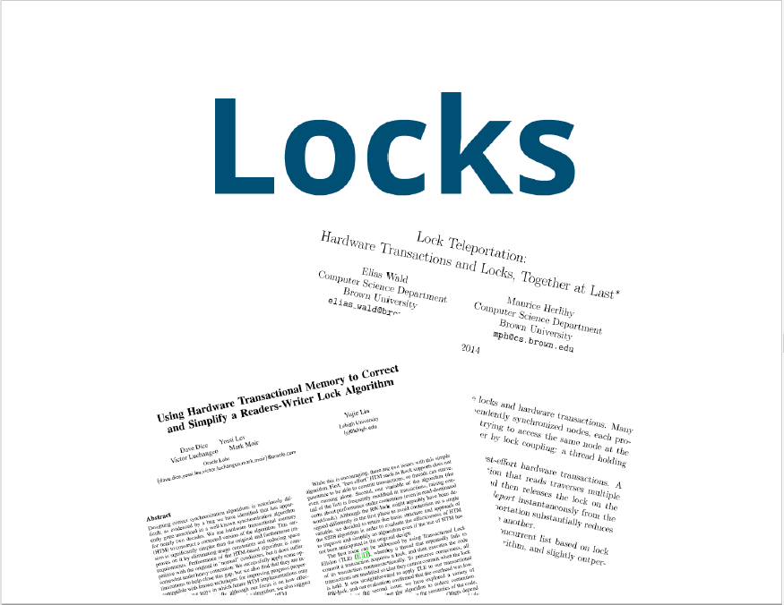
Locks and transactions complement one another

Slide 111
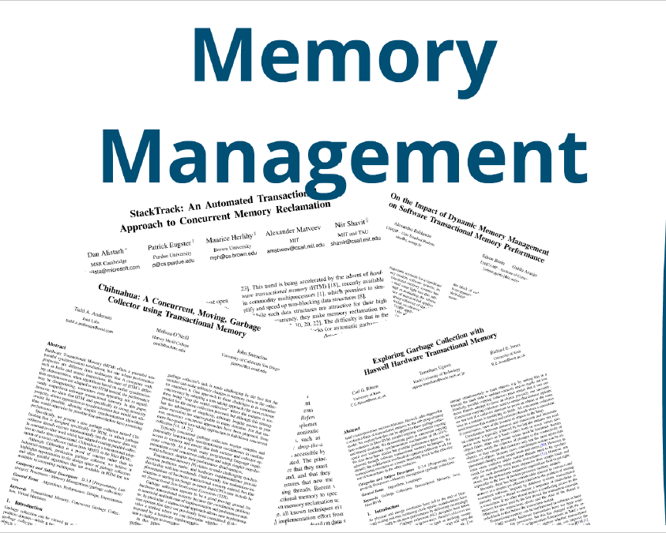
TM can improve memory management,
both automatic and explicit.

Slide 112
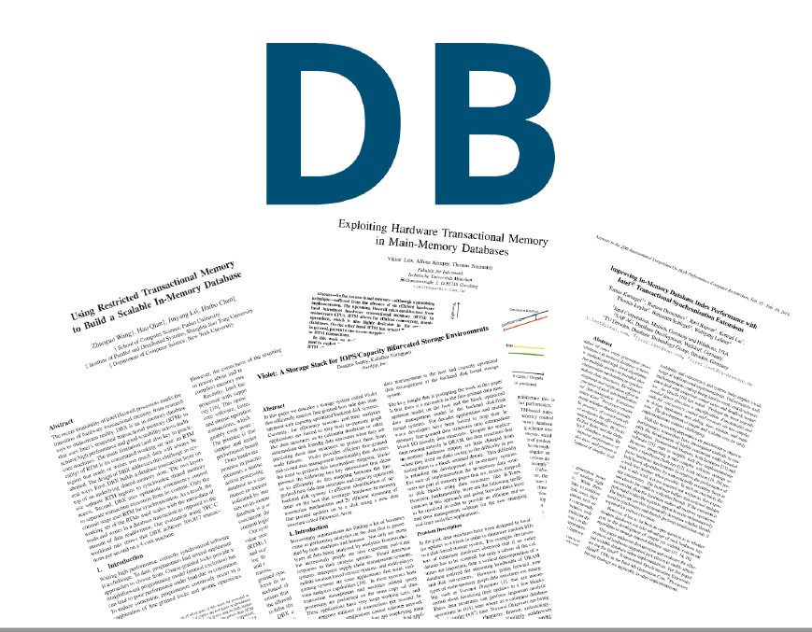
TM restructures in-memory databases

Slide 113
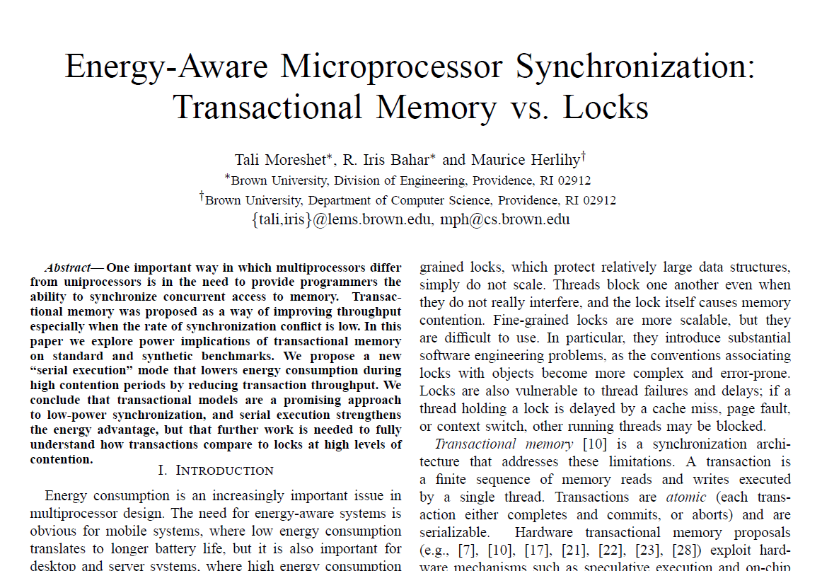
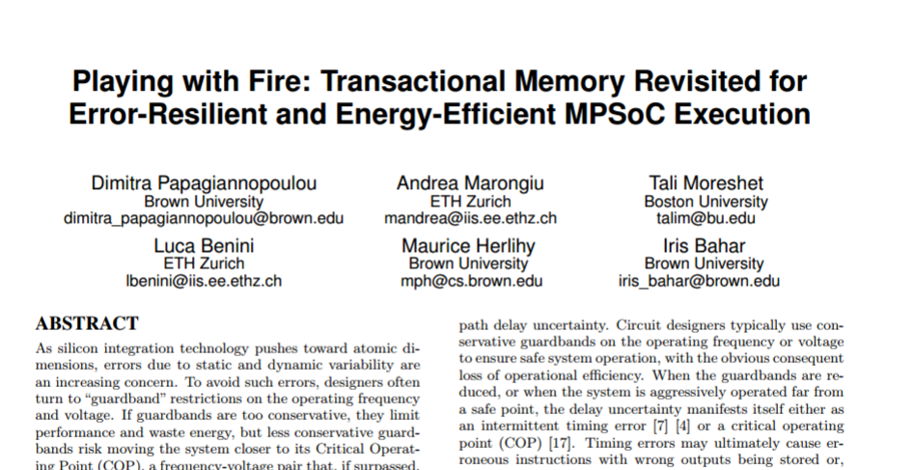
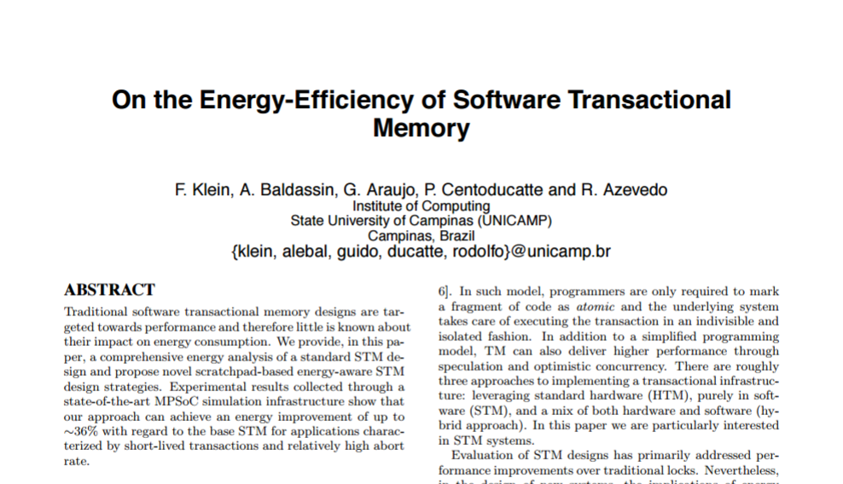
TM is energy-efficient

Slide 114
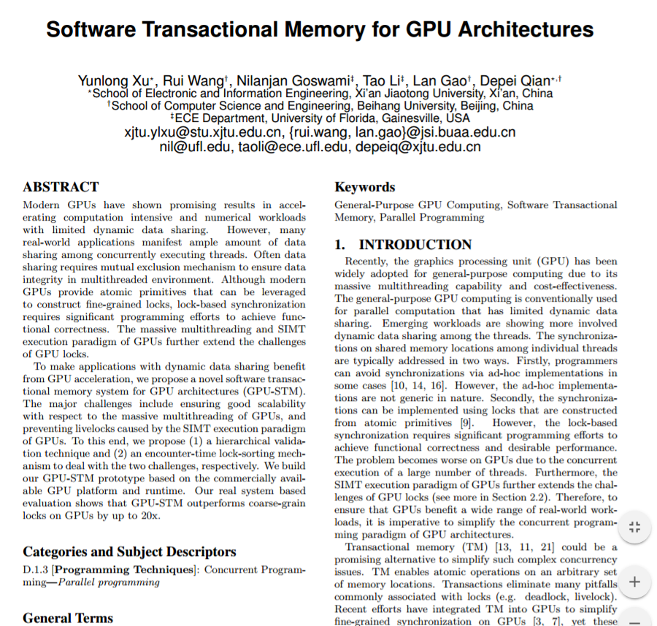
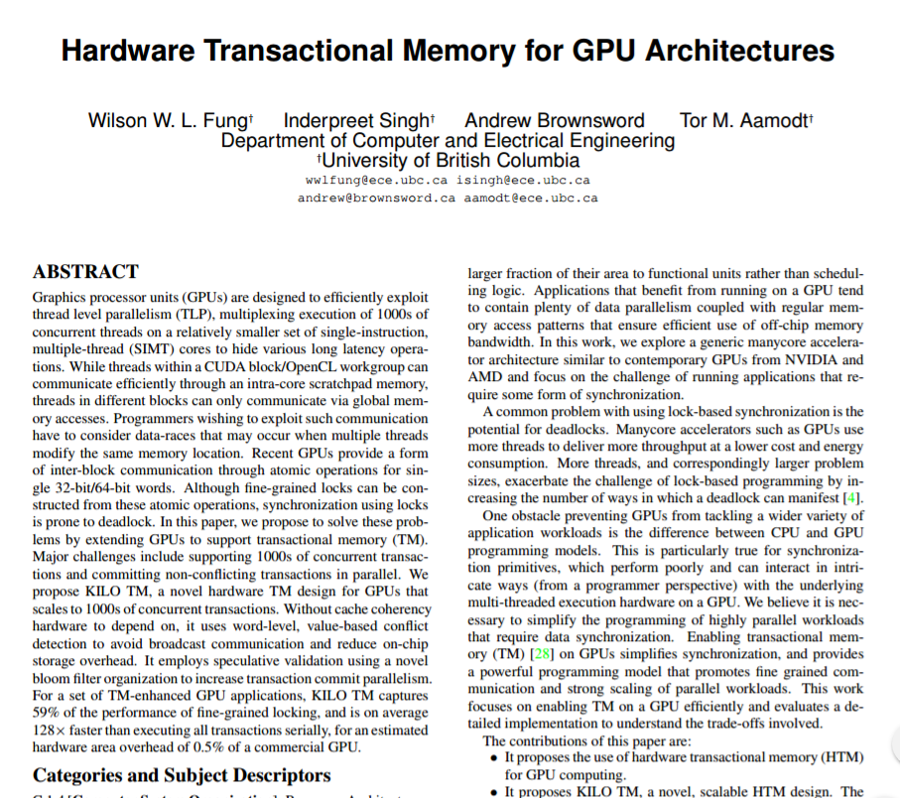
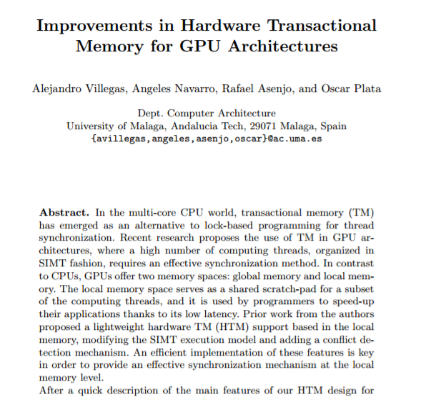
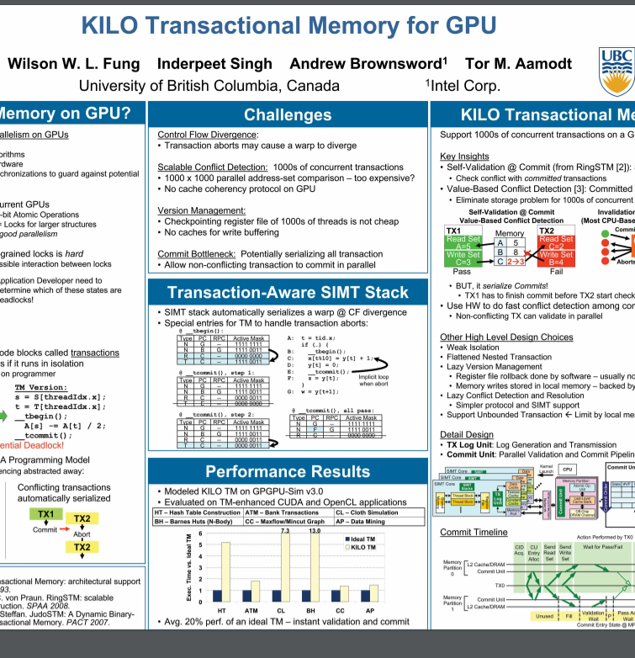
GPUs and accelerators need synchronization

Slide 115
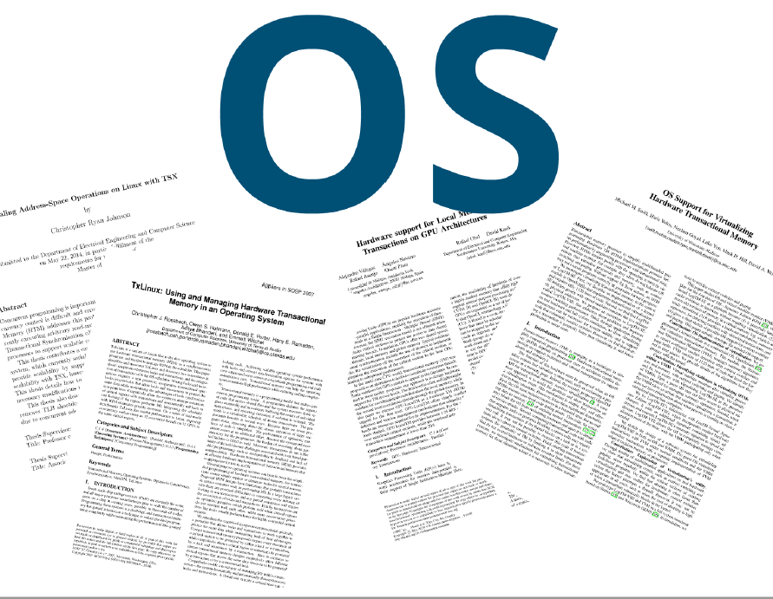
TM can simplify operating system kernels,
device drivers, security …

Slide 116
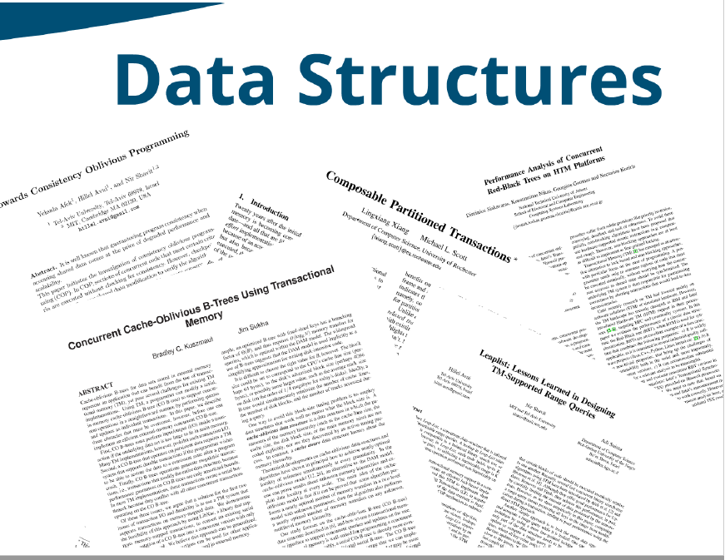
Transaction-Friendly data structures

Slide 117
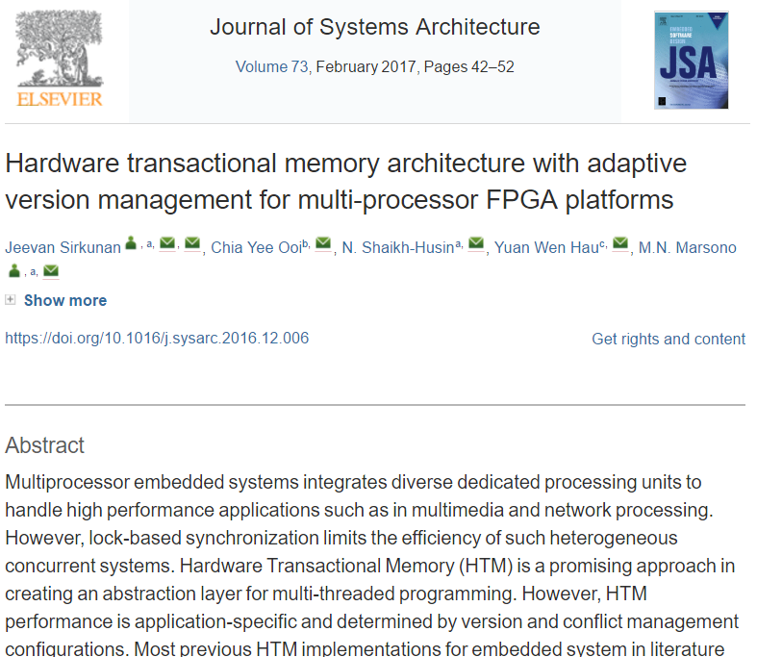
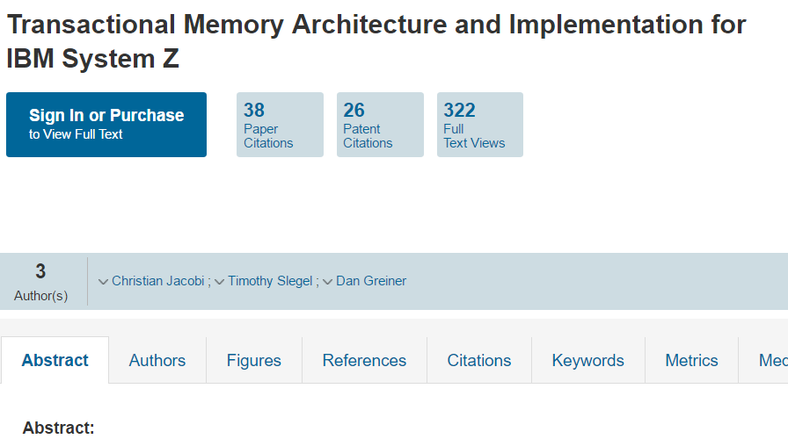
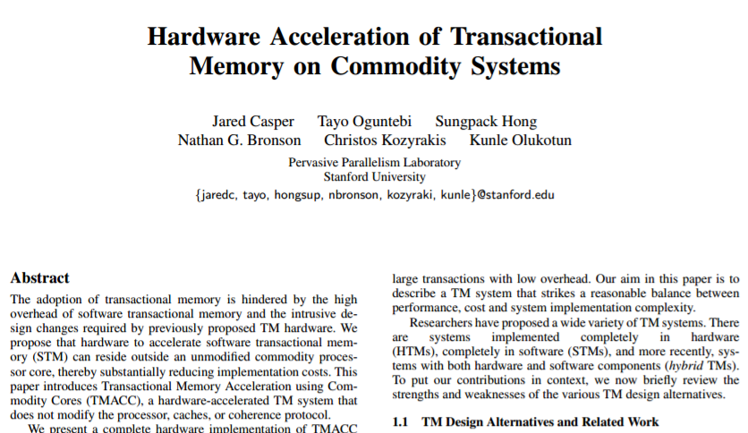
Computer Architecture

Slide 118
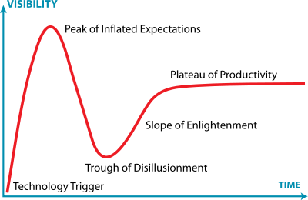
You are here
Hat tip: Jeremy Kemp
Notes:
Long story short, here is my view of the big picture.
Every new technology goes through some form of the “Gartner Hype Cycle”, named after the consulting firm that invented the notion.
An idea is born, and as it becomes known, people expect it to lead them out of the wilderness. Gradually, the community discovers that things are complicated, and that the new technology is not going to pay their mortgages, wash their cars, or solve perpetual motion. A reaction sets in, and some become bitter.
All along, researchers are patiently working on getting the damn thing to work, and eventually the technology settles into a stable, useful mode, less useful than the hype suggested, but better than the haters expect.

Slide 119
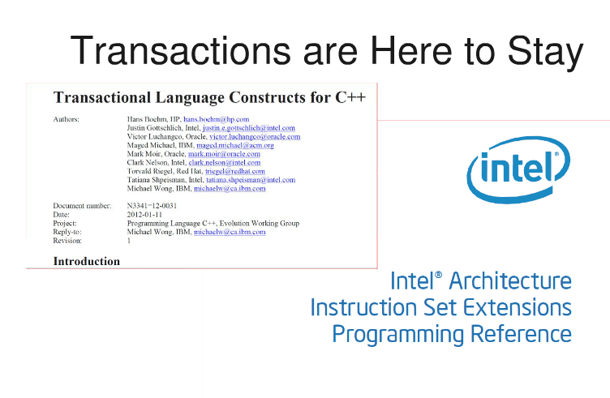

Slide 120
This work is licensed under a Creative Commons Attribution-ShareAlike 2.5 License.
You are free:
to Share — to copy, distribute and transmit the work
to Remix — to adapt the work
Under the following conditions:
Attribution. You must attribute the work to “The Art of Multiprocessor Programming” (but not in any way that suggests that the authors endorse you or your use of the work).
Share Alike. If you alter, transform, or build upon this work, you may distribute the resulting work only under the same, similar or a compatible license.
For any reuse or distribution, you must make clear to others the license terms of this work. The best way to do this is with a link to
http://creativecommons.org/licenses/by-sa/3.0/.
Any of the above conditions can be waived if you get permission from the copyright holder.
Nothing in this license impairs or restricts the author's moral rights.

